Slide 1
Sentiment analysis in r of twitter data
Jamey Johnston (@STATCowboy)

Slide 2
What is sentiment analysis
Text Analysis, Natural Language Processing and Computational Linguistics
Generally applied to reviews and social media (like Twitter and Facebook)
Aims to determine the attitude of the person on a certain topic, event or place
https://en.wikipedia.org/wiki/Sentiment_analysis (source)

Slide 3
Twitter Dev
https://dev.twitter.com/
Need to sign-up for developer access to Twitter to mine data
https://dev.twitter.com/rest/public/search (Search API)
NOTE: “The Search API is not complete index of all Tweets, but instead an index of recent Tweets. The index includes between 6-9 days of Tweets.”
Services exists to allow for mining historical data
https://gnip.com/

Slide 4
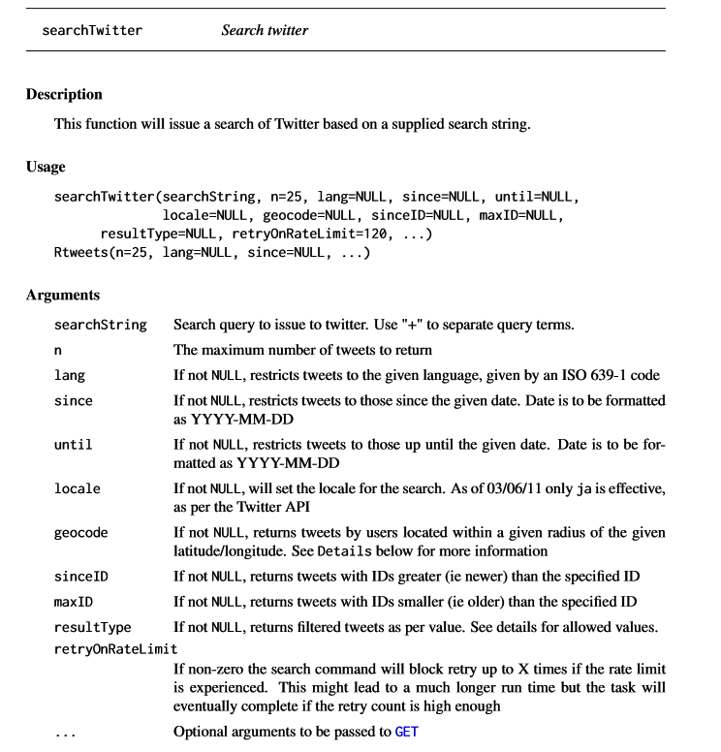

TWITTER PACKAGE IN R
https://cran.r-project.org/web/packages/twitteR/twitteR.pdf
searchTwitter
Main function to mine Twitter data
Notice the option “retryOnRateLimit”
Use to force R to keep retrying X times to get all data

Slide 5
Sentiment analysis using pos/neg Words
Analyze the text counting the number of “positive” and “negative” words
Uses word lists of “negative” and “positive” words
Considerations:
Need list in the language(s) of the data you are analyzing
Only looks at text! What about emoticons like emoji?
Machine Learning - Clustering / Topic Analysis

Slide 6
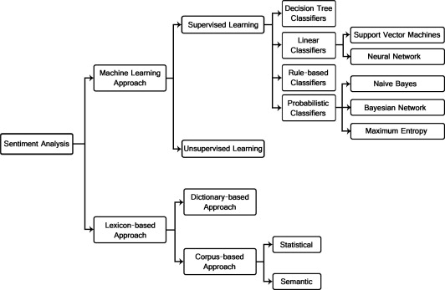
Sentiment Analysis techniques
http://www.sciencedirect.com/science/article/pii/S2090447914000550

Slide 7
Examples of Sentiment Analysis in R
Sentiment Analysis on Donald Trump using R and Tableau
https://www.r-bloggers.com/sentiment-analysis-on-donald-trump-using-r-and-tableau/
Mining Twitter for consumer attitudes towards hotels
https://www.r-bloggers.com/mining-twitter-for-consumer-attitudes-towards-hotels/
Code is a little older but shows an idea of comparing hotels using sentiment analysis

Slide 8
DEMOs
Download code @ http://STATCowboy.com

